Slide 1


Slide 2

PIPELINING IN COMPUTER ARCHITECTURE
Course: CSE 343.3 – Computer Architecture
Presented by
Razia Binte Alam Raya
Sumya Akter Asha
Umme Ayrin Tithi
2023100000110
2023100000369
2023100000377
Sanzida Islam
Md Aayat Hossain Mridha
2023100000447
2023100000457
2025 Sept’15

Slide 3
PIPELINING IN COMPUTER ARCHITECTURE
Enhancing Instruction Execution in Computer Architecture
Topics
Introduction of Pipelining
5 Stages of load
Pipelining in CPUs
Types of pipelining
Single Cycle execution
Multicycle execution
Single Cycle vs Multicycle execution
Advantages of pipelining
Limitations of pipelining

Slide 4
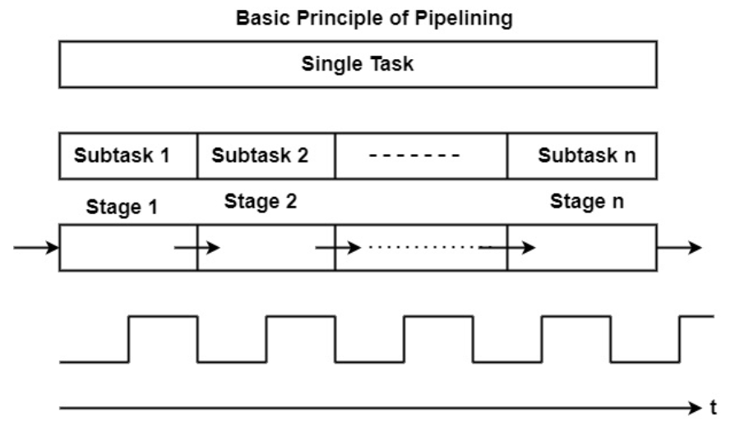
What is Pipelining?
Pipelining = breaking a sequential process
into smaller sub-operations or stages.
In pipelining, each stage works in its own
segment separated by registers, and as one
stage finishes, the next starts, allowing tasks
to overlap in time.

Slide 5




Car Wash Pipeline Example
Stages:
Washing – Spray water and soap on the car.
Scrubbing – Brushes clean the car.
Rinsing – Water removes soap.
Drying – Blowers or towels dry the car.
6 PM
7
8
9
10
11
12 AM
30
30
30
30
30
30
30
30
30
30
30
30
30
A
Task Order
B
C

Slide 6
CPU Execution
CPUs can execute instructions in different ways to balance speed, complexity, and efficiency.
CPU Execution Approaches
Single-Cycle Processor
Executes one instruction in one clock cycle
Simple but slow clock speed
Multi-Cycle Processor
Executes instruction over multiple clock cycles
Allows faster clock, more efficient

Slide 7
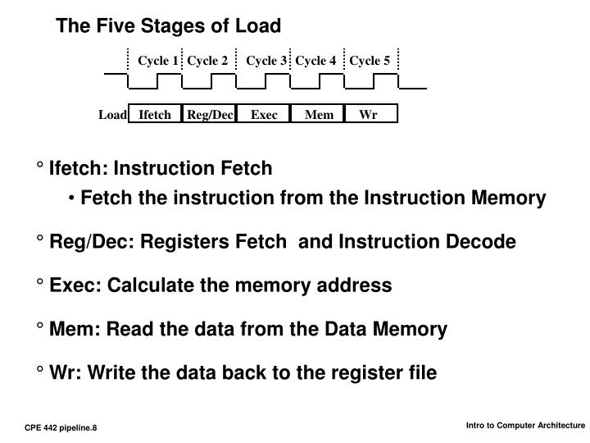
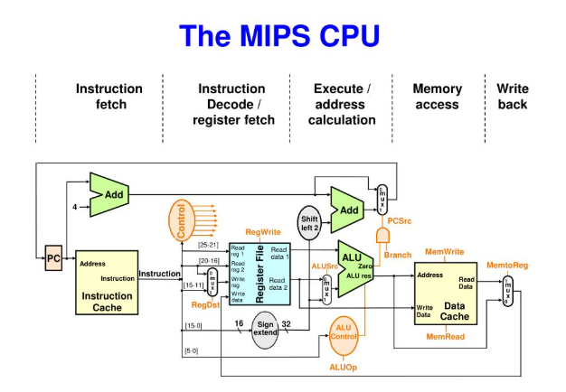

Slide 8
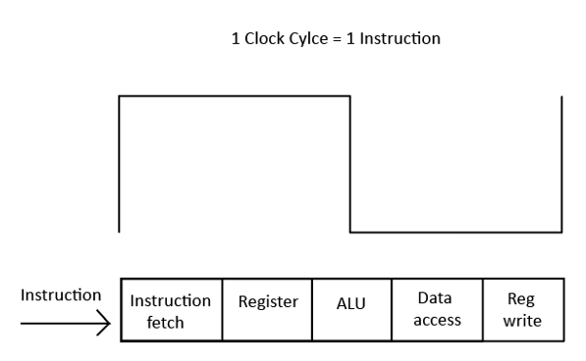
Sequential Execution (Non-Pipelined / Single-Cycle)
Executes one instruction at a time.
Each instruction completes in one clock cycle.
Simple design.
0 ns
8 ns
16 ns
18 ns
Time
Instruction
fetch
Data
access
Reg
Write
lw $1, 100($0)
Reg
ALU
Program Execution Order
Instruction
fetch
Data
access
Reg
Write
lw $2, 200($0)
Reg
ALU
8 ns
lw $3, 300($0)
Instruction
fetch
8 ns
8 ns

Slide 9
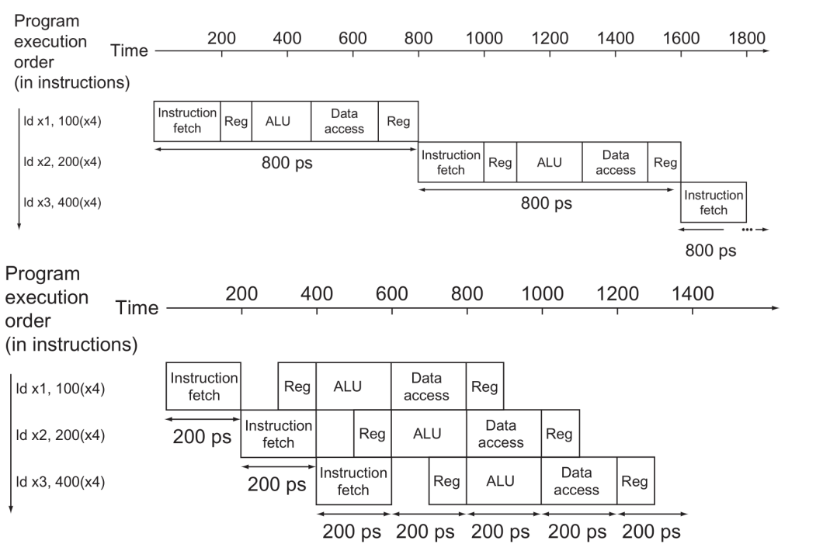
Multi-Cycle Processor
Executes instructions in multiple steps:
  Fetch → Decode → Execute → Memory → Write-back
One step per clock cycle
Faster clock than single-cycle design

Slide 10




Difference between Single Cycle and Multicycle
Single Cycle Execution
Multi-Cycle Execution
Instruction Execution
Whole instruction in one clock cycle
Instruction Execution
Instruction divided into multiple steps
(cycles)
Clock Speed
Slow (must accommodate slowest instruction)
Clock Speed
Faster (each step is shorter)
Design Complexity
Simple
Design Complexity
Slightly more complex
Instruction Overlap
None
Instruction Overlap
Minimal without pipelining

Slide 11

Advantages
Sequential / Single-Cycle Processor:
Simple and easy to design
Easy to understand and implement
No complex control logic
Multi-Cycle Processor:
Faster clock speed (each step is shorter)
More efficient use of hardware
Can handle complex instructions better

Slide 12
Hazards in Processors
Single-Cycle Processor:
Structural Hazards: Rare (everything in one cycle)
Control Hazards: Need to worry about branch instructions
Data Hazards: Usually minimal (no instruction overlap)
Multi-Cycle Processor:
Structural Hazards: May occur if same hardware used in multiple steps
Control Hazards: Need to handle branch instructions carefully
Data Hazards: Can occur if instruction depends on result of previous step

Slide 13

What do you think?
Which is better?

Slide 14
Thank You Everyone

